Slide 1
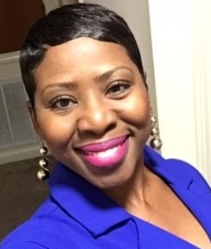
How to SUPPORT me…. --Don’t “box me in” --Help me understand by sharing different perspectives --I may become longwinded when venting--please yield time & attention! --Don’t intellectualize me from a “textbook” standpoint (connect with my feelings/emotions)
Courtney Williams
--FOLLOW THROUGH! If you said it, then do it. If you can’t, touch base and let me know.
Favs/things I love:
Thursday--favorite day
Orange---favorite color
Pound cake
SHOES, SHOES, SHOES!!!
Music
Good food
Other things about me:
* I’m surface when sharing unless I feel heard.
* I am introverted and can be very quiet at times.
* I’m stubborn about things that directly affect me.
* This year has been great but painful at the same time.
* I’m becoming a “new me.”
What people LIKE & ADMIRE about me…
~Good listener ~Takes initiative
~Organized ~Friendly
~Fashion sense ~Supportive ~Compassionate ~Considerate
~Perspective
IMPORTANT TO me….
Having trust/camaraderie with my supervisor/DT.
Representing MS-PCPI and USM well.
Creating a fun training environment for learning.
Explaining PCT skills for the “aha” of understanding and application.
Creating a life of peace. At this point, I will walk away from ANYTHING disrupting peace within my life.

