Slide 1
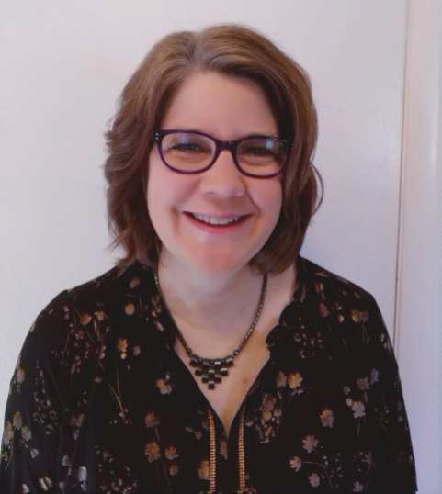
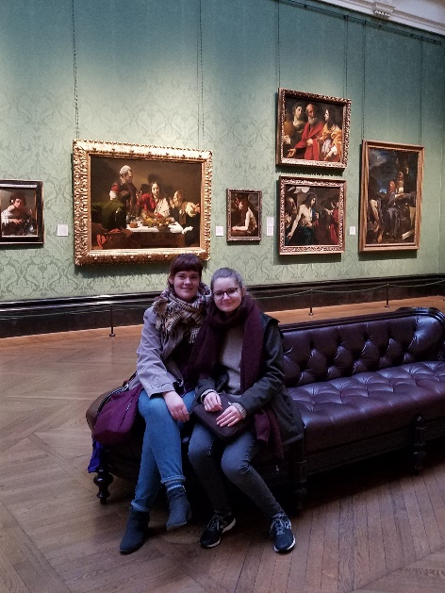
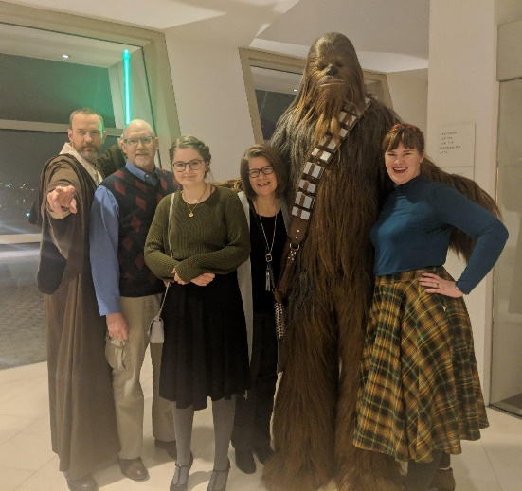
Cheryl Laaker PCT Trainer
Important to Cheryl as a PCT trainer:
People respecting my knowledge and years of experience in helping individuals have the best life possible
Having the opportunity to share my passion for Person Centered Thinking
Creating a safe space for people to share and explore how PCT can work for them in their lives and at work
Participants showing they are engaged by participating in activities and asking questions
Participants finding value in the skills learned
Feeling prepared and having the resources needed to provide the training
What others like and admire about Cheryl:
Always attentive and truly listens to my needs
Can always count on her to be a team player
Quiet, yet full of passion for PCT
Always has a smile to share
Really knowledgeable about thinking outside the box to support our members
Makes learning fun
She can find the good in anyone
Ways you can support Cheryl:
Truly listen and focus without distractions during the training
Share your passion for PCT – supporting people of all shapes and sizes
Assure all technology is working and available for training as requested
Provide clear and honest feedback to enhance the learning experience
Show you are engaged by sharing stories and asking questions

