Slide 1
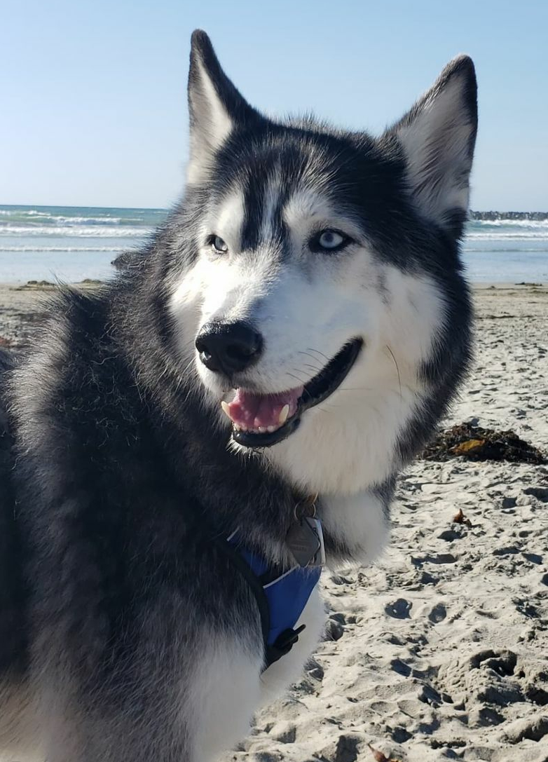
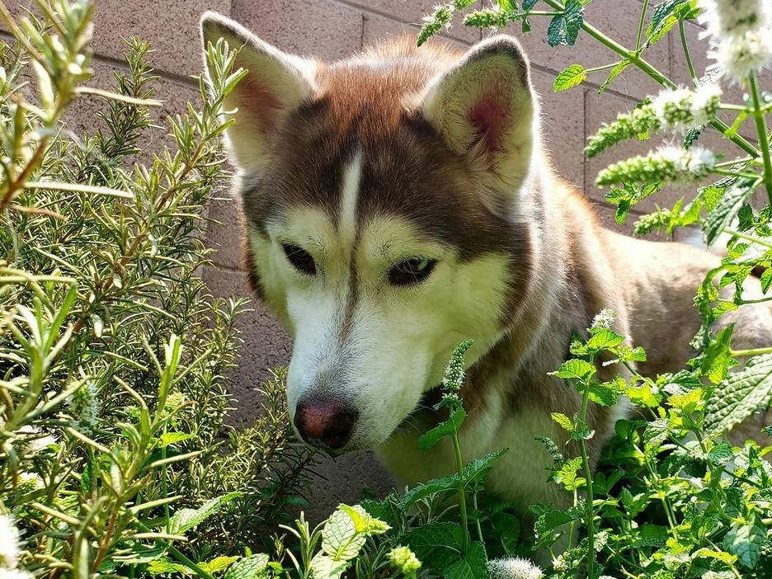
Things that are Important To Me as a Trainer:
To be a knowledgeable, engaging trainer
Effectively facilitate resulting in learner comprehension, participation & enjoyment
What Others Say About Justine…
She is compassionate & understanding
She is helpful & organized
She is a knowledgeable trainer
Continuous Improvement: ongoing curriculum development committees
Organization and preparation for well executed class sessions
Leverage learning & development technology / applications
Health and Wellness
She is an effective listener
She has a sense of humor with an animated personality
She enjoys to cook & garden
She loves her dogs
Ways to Best Support Me as a Trainer!
Development opportunities for continued growth & education
Encourage balance
Team engagement & project workgroup experiences
Provide opportunities for team collaboration & 1:1 supervision
Direct, honest & clear communication
Justine McDowell
PCT Trainer

