Slide 1
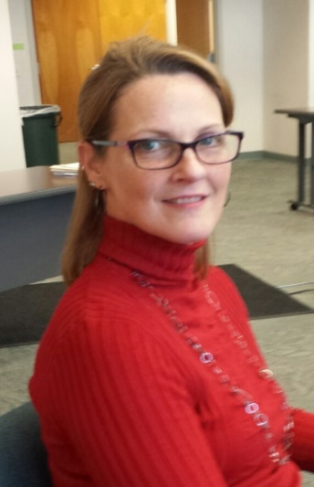
Lori Hood
PCT Coach and Trainer
What Others Like And Admire About Me:
My enthusiasm for all things Person Centered
I listen and I am a good sounding board
I know when to lead and when to empower
I have a positive outlook in every situation – Rose colored glasses!
I am organized, patient, understanding and enjoy sharing my ideas with others
I don’t take myself TOO seriously! I like to have fun!
What’s Important To Me:
Work = Life balance
Flexibility
Having a routine and sticking to it
Receiving positive feedback
Teaching direct support staff in a person centered manner
Networking and seeing how things are working in different settings
Working as a team
Inclusion of others
How To Best Support Me:
Provide clear directions and timelines
Freedom to be ME!
Set realistic goals
Provide constructive feedback in a timely manner
Communicate through emails – follow up a phone call with an email that outlines expectations
Understanding that my full time job can be unpredictable

