Slide 1
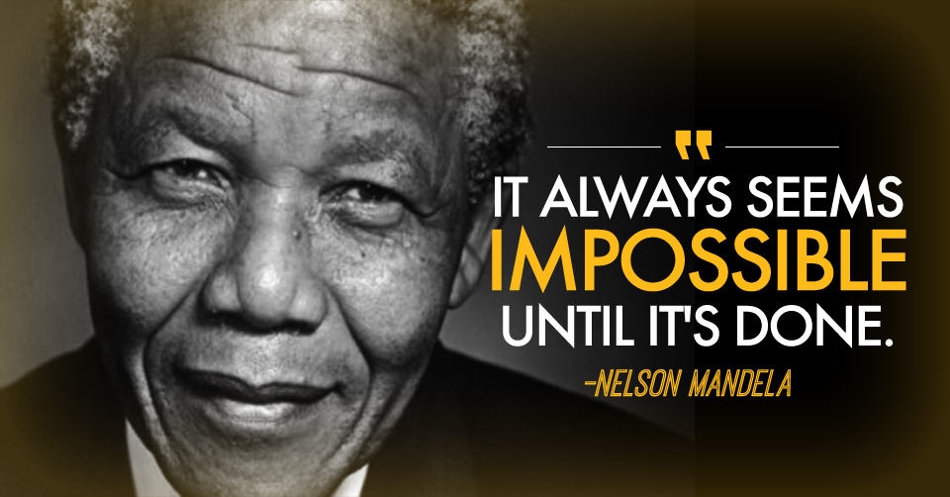
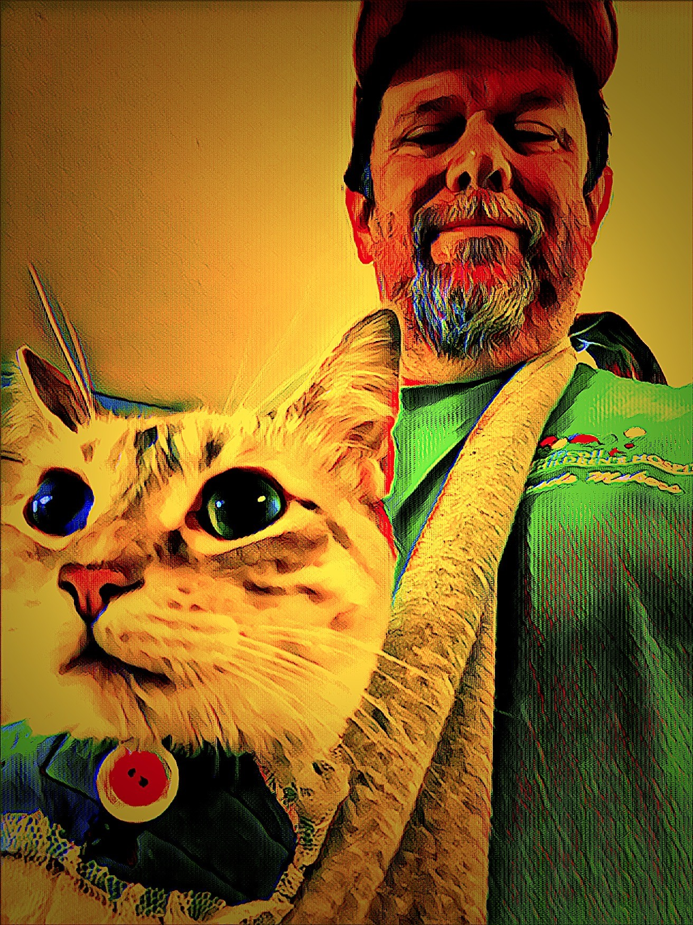
What people like and admire about Scott: Knowledgeable Empowering Animal Advocate Honest Resource Loyal Professional Passion And Compassion
Characteristics of those who support Scott:
Hard Worker Compassionate Global Thinker Honest Dedicated Respectful Open to Ideas Funny Analytical
What import to Scott:
Time with Wife and Pets
Working with Dedicated People
Creating Positive Impact on community
Opportunity to do work the right way
Love
Compassionate Service
Positivity
Recognize My Good Work but avoid effusive praise
Animals – Africa - Music
Supports needed to stay happy:
Give Feedback or Guiding Questions
Providing Time to Process
Allowing Space to complete Work
Checking in on Progress
Demonstrate Trust and support
Timelines and Action items are helpful

