Slide 1
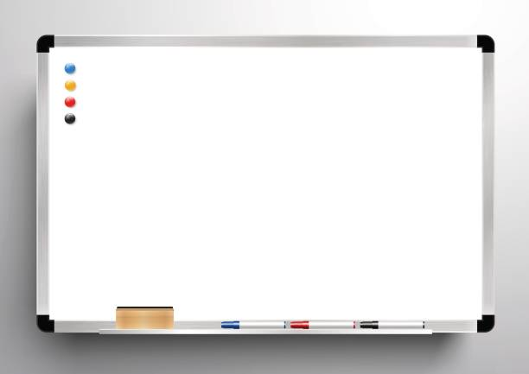
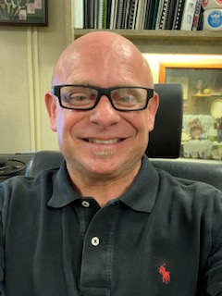
Best Way to Support Me
If you have learned something or something has impacted you from training, please tell me. It inspires me.
Please tell me if you think there is something that I could improve upon, do or say differently to be more effective. I value honest and direct(I don’t do hints well)feedback. I can handle it!
I love to tell stories to illustrate, however, this can cause me to lose track of time (especially if I’m passionate about a subject). I may need a gentle reminder or signal to “land the plane” and move on.
Like and Admire
Funny
Creative
Real
Engaging
Passionate about training
Knowledgeable
Professional
Caring
Important To
Seeing people have “Aha” moments
Impacting people’s lives through training
People laughing and having fun while learning
Hearing people share what they have learned with others
Hearing personal life stories of how training has impacted someone’s life
Learning new things to share with others (life long learner)
Participants that have a desire and passion to learn more and eager to put training into practice
TROY

